Slide 1

Life-Cycle Carbon Footprint Analysis of a 5G Base Station
Submitted To: Dr. Purnendu Karmakar
Submitted By: Himi Vyas (23UEC550), Vidushi Sharma (23UCC614), Vibha Gupta (23UEC642)
Course name: Introduction To Green Communication and Networking
Institute: The LNM Institute of Information Technology, Jaipur

Slide 2

Domain: Sustainability / Carbon Accounting Problem Number: Problem 40
Objectives:
To perform a simplified Life Cycle Assessment (LCA) of a 5G base station:
Tools used: Python (NumPy, Pandas, Matplotlib)
To quantify carbon emissions across manufacturing, operation, and end-of-life:
Tools Used: Spreadsheet-based analysis
To evaluate CO₂ reduction potential using renewable energy and sleep-mode optimization.
Tools used: Data visualization & scenario simulation

Slide 3
Problem Statement & Solution Overview

Slide 4
The Problem: Escalating Energy Demands
The deployment of 5G networks has significantly increased energy consumption due to:
High-power base stations
Continuous 24×7 operation
Large-scale infrastructure rollout
This results in a high life-cycle carbon footprint, which must be quantified and optimized to meet sustainability goals.
Our Solution: A Holistic LCA Approach
We propose a comprehensive Life Cycle Assessment (LCA) for a single 5G base station. To Perform a Life Cycle Assessment (LCA) of a 5G base station
Model emissions from:
Manufacturing
Operational energy use
End-of-life recycling
Evaluate CO₂ savings using:
Renewable electricity
Sleep-mode energy optimization
Implement simulations and visualizations using Python.

Slide 5
Background & Research Findings
Why LCA is Crucial for 5G
Operational energy accounts for over 70% of telecom emissions.
Manufacturing emissions are significant and front-loaded in the lifecycle.
End-of-life recycling offers substantial carbon recovery opportunities.
Key Research Insights
Typical base station power consumption: 3–6 kW.
Telecom sector contributes 2–3% of global CO₂ emissions.
Renewable energy can cut emissions by 60–90%.
Sleep-mode optimization can save 20–40% operational energy.
These insights underscore the importance of a comprehensive LCA to pinpoint critical emission hotspots and evaluate effective reduction pathways.
A deep dive into the literature reveals key drivers of telecom carbon emissions and promising mitigation strategies.

Slide 6
Foundation of Our Analysis: Data & Assumptions
Our model is built upon robust data and clearly defined assumptions to ensure accurate and reliable results.

Slide 7

Authoritative Data Sources
Telecom energy studies (3GPP, GSMA reports)
Lifecycle emission data for renewable electricity
Academic LCA models for Information and Communication Technology (ICT) infrastructure
ICT life-cycle assessment literature
Industry-standard emission factors

Slide 8
Critical Assumptions for Our Model
Base station lifetime | 10 years
Average power draw | 5 KW
Manufacturing energy | 30,000 KWH
End-of-life energy | 2,000 KWH
Grid emission factor | 0.55 kg CO2/KWH
Renewable emission factor | 0.55 kg CO2/KWH

Slide 9
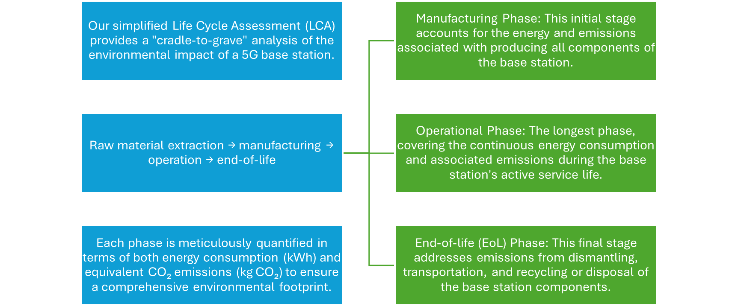
The Life Cycle Assessment (LCA) Framework

Slide 10
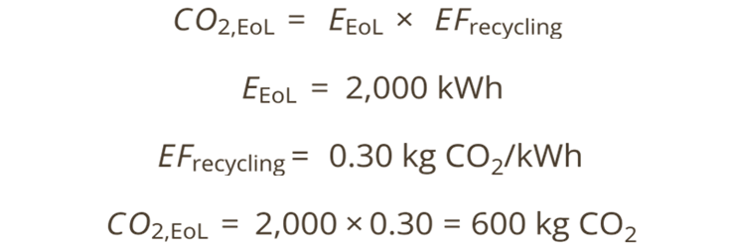
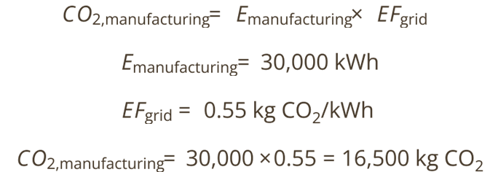
Manufacturing and End-of-Life Carbon Footprint: Quantifying the emissions from the creation and decommissioning of a 5G base station.
Manufacturing Phase Emissions:
This phase encompasses the entire supply chain, from raw material extraction and semiconductor fabrication to antenna production, power electronics assembly, and finally, transportation and installation at the site.
Formula Used:
End-of-Life Phase Emissions:
The end-of-life phase involves the processes of recycling, dismantling, and recovering valuable materials, minimizing waste and potentially offsetting some initial emissions.
Formula Used:

Slide 11

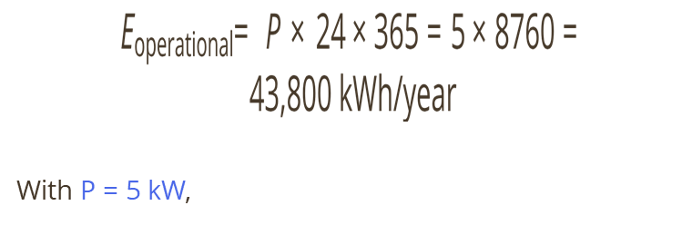
Operational Emissions & Strategic Optimization The operational phase is the most energy-intensive, presenting the greatest opportunities for CO₂ reduction.
Annual Operational Energy:
The continuous operation of a 5G base station results in substantial annual energy consumption.
Operational CO₂ Emissions:
The carbon footprint during operation depends heavily on the energy mix.
r: Percentage of renewable energy
EFrenewable: Renewable emission factor
EFgrid: Grid emission factor

Slide 12
Key Optimizations Model:
Sleep Mode Implementation: Achieving a 30% reduction in energy consumption during off-peak hours.
Renewable Energy Integration: Exploring scenarios with 30–100% clean energy supply for the base station.

Slide 13

Our Approach Towards the Solution
We have developed a comprehensive modeling framework to evaluate diverse strategies for emission reduction.
Five Core Scenarios Simulated:
Baseline (Grid only): Represents current standard operation with 100% grid electricity.
100% Renewable:Full reliance on clean energy sources for operation.
Mixed Grid (30% Renewable): Partial integration of renewable energy into the grid supply.
Sleep Mode: Implementing intelligent power-saving features during low traffic.
Sleep + Renewable: A combined approach for maximum carbon reduction.
Why This Approach is Pivotal?
It accurately mirrors real-world deployment challenges and opportunities.
Facilitates direct comparison of both policy-driven and engineering-led solutions.
The model is scalable, allowing for city- or country-level analysis of 5G infrastructure impact.

Slide 14
Implementation & Methodology:
Implementation Details:
All computational analyses were conducted using Python, leveraging its powerful data science libraries. We employed Pandas for calculating annual and cumulative emissions trajectories, whilst implementing scenario-wise comparisons through carefully parameterised models to ensure accuracy and reproducibility.
Total CO₂ Emission Formula:
This comprehensive formula captures the complete life-cycle carbon footprint, from initial production through operational deployment to end-of-life disposal.
Scenario-Wise Lifetime Emissions Summary:
Scenario | Manufacturing (tCo2) | Operational (tCO2) | End-of-Life (tCO2)
Baseline | 12.5 | 285.0 | 2.8
50% Renewable | 12.5 | 142.5 | 2.8
100% Renewable | 12.5 | 28.5 | 2.8
Sleep mode active | 12.5 | 199.5 | 2.8
Sleep + Renewable | 12.5 | 45.6 | 2.8

Slide 15
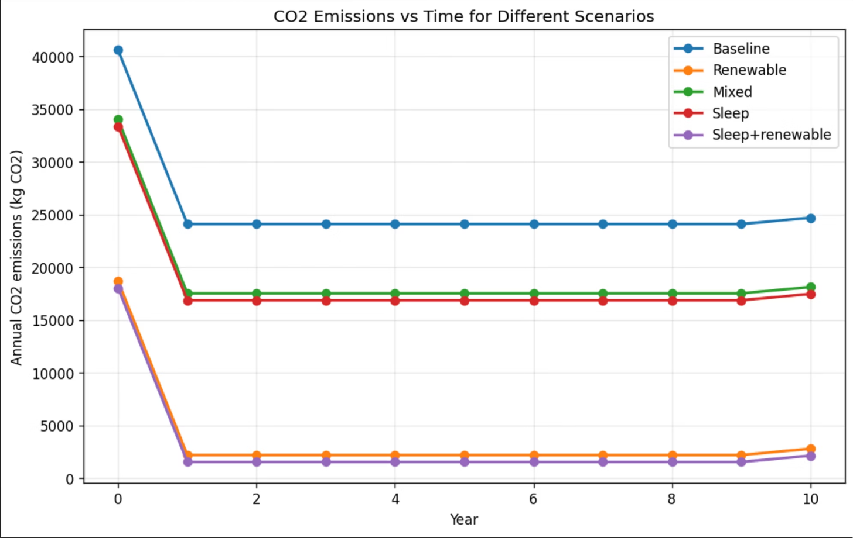
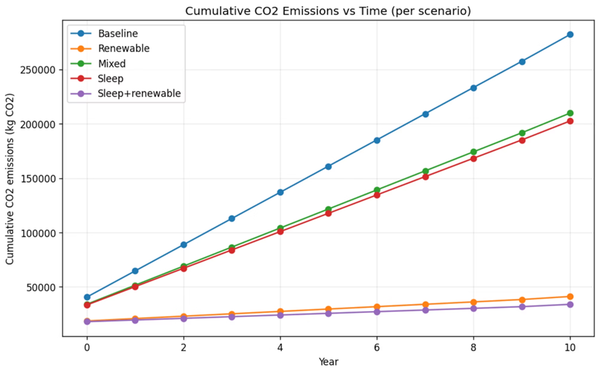
Results – CO₂ Emissions vs Time
Manufacturing spike: Initial emissions peak at Year 0 due to base station production and deployment activities
Operational Dominance: Yearly operational emissions constitute the primary ongoing carbon impact throughout the lifecycle
Renewable Advantage: Renewable and sleep-mode scenarios demonstrate significantly lower emission trajectories

Slide 16
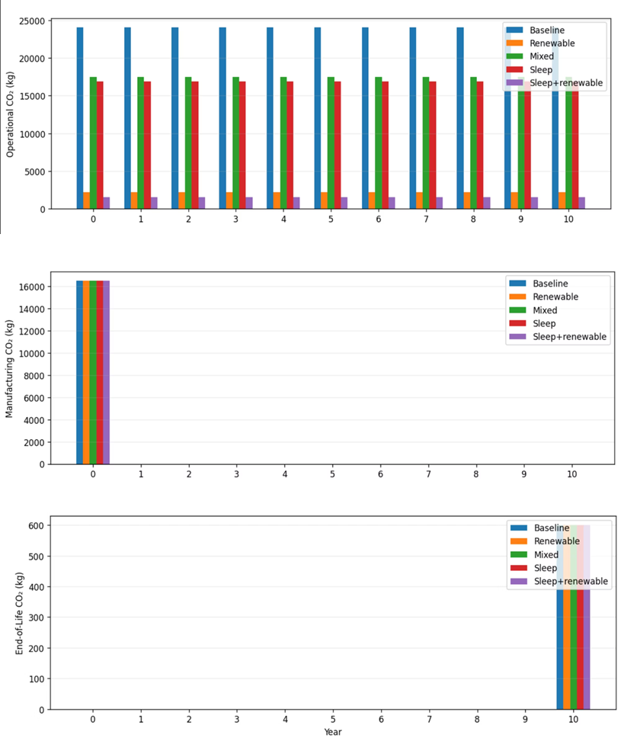
Results – Component-Wise Emissions
Graph Interpretation:
Manufacturing emissions occur only once at the beginning of the lifecycle, corresponding to equipment production and deployment.
Operational emissions are recurrent and accumulate annually, making them the dominant contributor over time.
End-of-life emissions appear only in the final year, associated with decommissioning, recycling, and disposal processes.
Critical Observation:
The operational phase contributes more than 85% of total lifetime CO₂ emissions, clearly indicating that energy efficiency improvements and clean electricity adoption during operation offer the greatest mitigation potential.

Slide 17
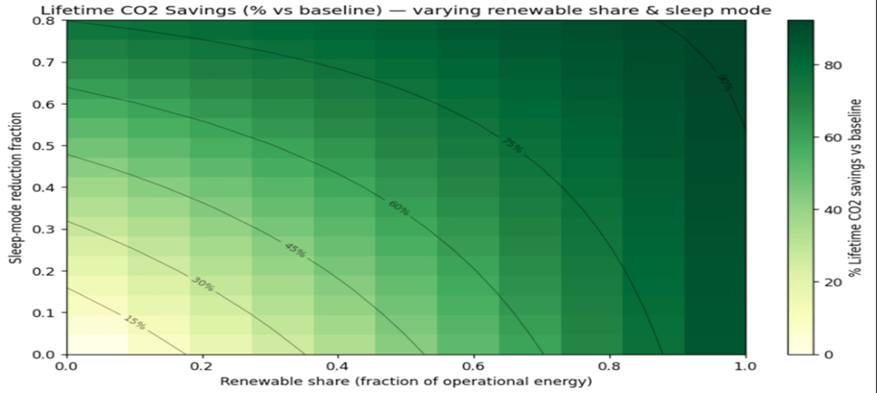
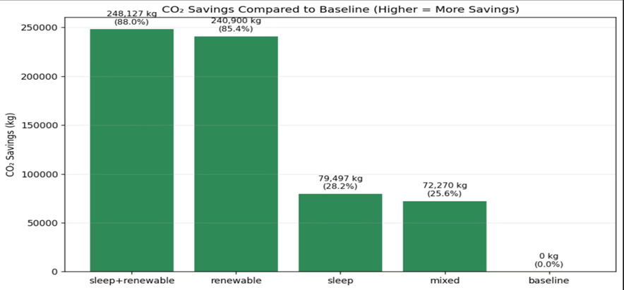
Results – CO₂ Savings Analysis
Maximum Reduction (85.90%): Achievable lifetime emission reduction through combined strategies (Sleep + Renewable)
Renewable Impact (80.85%): Emissions reduction from 100% renewable electricity adoption
Sleep Mode Benefit (25-30%): Additional savings from intelligent sleep-mode optimisation
Renewable-only strategy: Achieves approximately 80–85% CO₂ reduction, demonstrating that clean electricity is the single most impactful measure.
Sleep mode-only strategy: It provides 25–30% CO₂ savings, highlighting the benefit of intelligent energy management during low-traffic periods.
Combined sleep mode + renewable strategy: It delivers the maximum reduction, achieving 85–90% lifetime CO₂ savings.
Baseline strategy: The baseline case shows zero savings and serves as a reference.

Slide 18
Final Conclusions:
Operational Energy Dominance: The operational phase overwhelmingly dominates the 5G base station carbon footprint, accounting for the vast majority of life-cycle emissions.
Renewable Electricity Effectiveness: Transitioning to renewable electricity emerges as the most impactful mitigation strategy, offering substantial emission reductions across the entire operational lifetime.
Sleep-Mode Optimisation Benefits: Intelligent sleep-mode scheduling provides meaningful additional savings, particularly when combined with renewable energy sources.
Manufacturing Impact Context: Manufacturing emissions become proportionally less significant over extended operational lifetimes, reinforcing the importance of operational efficiency.
Overall Outcome: A combined strategy integrating energy-efficient operation and renewable electricity supply can drastically reduce the life-cycle carbon footprint of 5G base stations while maintaining network performance and reliability.

Slide 19
Contribution to Global Sustainability
Why This Study Matters
With millions of 5G base stations projected for worldwide deployment over the coming decade, even modest per-station carbon savings scale to create massive global environmental impact.
Each optimised base station represents a meaningful contribution to climate mitigation goals, and when multiplied across entire telecommunications networks, the cumulative effect becomes transformative.
Real-World Benefits:
Green Network Design: Empowers telecom operators with evidence-based strategies to design and deploy environmentally responsible network infrastructure from the ground up.
Carbon-Neutral Planning: Supports comprehensive carbon-neutral infrastructure planning initiatives, enabling operators to meet ambitious sustainability commitments and regulatory requirements.
Climate Goals Alignment: Directly contributes to global climate objectives and sustainability frameworks, including Paris Agreement targets and UN Sustainable Development Goals.

Slide 20
Future Scope & Improvements
Region-Specific Grid Modelling: Develop detailed emission models accounting for regional electricity grid compositions and carbon intensities across different geographical markets.
AI-Based Dynamic Scheduling: Implement artificial intelligence algorithms for intelligent, traffic-aware sleep scheduling that adapts in real-time to network demand patterns.
Traffic-Aware Power Optimization: Create sophisticated power management systems that dynamically adjust energy consumption based on actual network traffic and user demand.
Large-Scale Network Simulations: Expand analysis to encompass entire network-level simulations, capturing interactions between multiple base stations and infrastructure components.
Comprehensive Energy Integration: Incorporate additional energy consumers including cooling systems, backhaul connections, and supporting infrastructure into the holistic life-cycle assessment.

Slide 21
References:
GSMA. Mobile Energy Efficiency and Sustainability Reports.
3GPP. Green Networking and Energy Efficiency Standards (Releases 16–18).
ISO 14040 & ISO 14044. Life Cycle Assessment — Principles and Framework.
E-coinvent Database. Life Cycle Inventory Data for Energy Systems.
IPCC. Guidelines for National Greenhouse Gas Inventories.
IEEE Communications Magazine. Special Issues on Green and Sustainable Networks.
IEEE Transactions on Green Communications and Networking.
Elsevier Journal of Cleaner Production.
Renewable Energy LCA Databases (NREL, IEA).

Slide 22
Contributions:
Himi Vyas | 23uec550 | 33.33%
Vidushi Sharma | 23ucc614 | 33.33%
Vibha Gupta | 23uec642 | 33.33%

Slide 23
Thank You

